Slide 1
Pivotal Software Chile
Meetup Junio 2019
Alejandro Pacheco
Armando Salas
Junio 2019

Slide 2


Bienvenidos al Meetup
Notes:
Resting slide on screen before you begin presenting.

Slide 3

Agenda
¿Qué es Pivotal? - Armando
Principales Componentes de la Plataforma de Pivotal - Alejandro
Principales Proyectos OSS en los que trabajamos y nuestros socios principales. - Alejandro
Introducción a Arquitectura de Microservicios - Alberto Alcaide / Daniel Carvajal
Próximos Eventos / Q+A

Slide 4


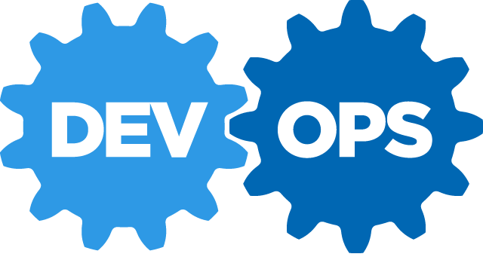

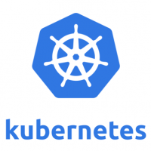

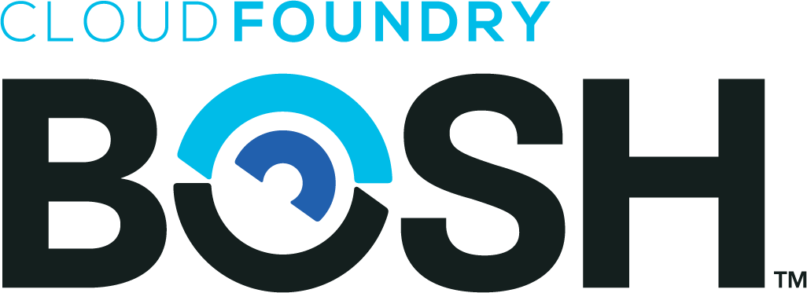


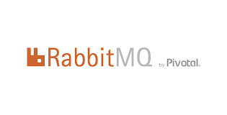

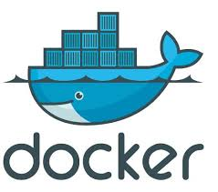
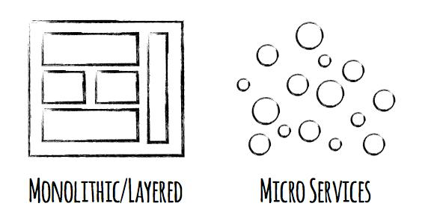

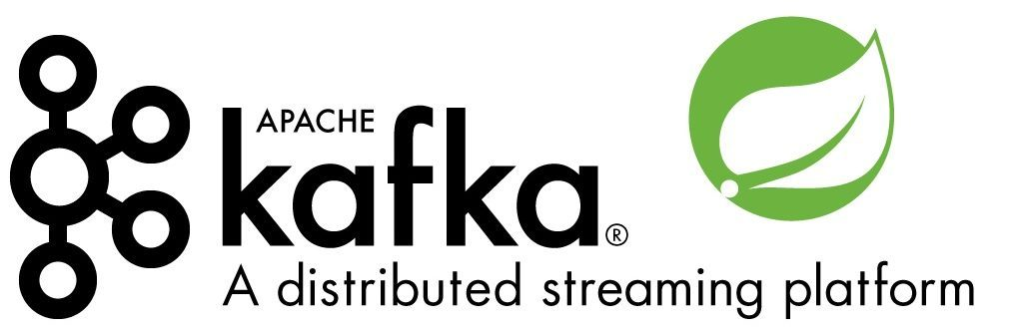
El mundo del software ha cambiado…
Continuous Delivery
Notes:
Software is changing industries but software itself is changing. You hear a lot about buzz-words and new technologies coming to play with ideas such as Microservices, DevOps, Continuous Delivery and of Containerization of workloads made popular by Docker

Slide 5
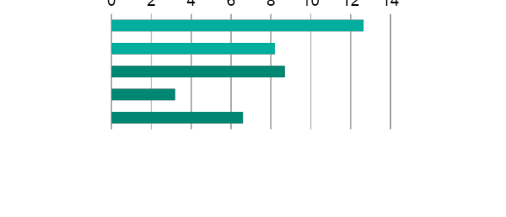
Los desarrolladores de software gastan demasiado tiempo NO escribiendo su software
Design and Coding
Brainstorming
Administrative tasks
Managing Environments
Waiting for Test/Build
Average Hours/Week
Sources: “LinkedIn Survey to software developers”
Notes:
And here’s the reality.
You have a precious resource that’s spending TOO much of their time, not doing what you hired them to do. And for good reason.

Slide 6

WE build the container
YOU build the container
Application Code & Frameworks
Buildpacks | Spring Boot | Spring Cloud | Steeltoe
Continuous
delivery
Github
Public Cloud Services
Pivotal Network
Open Service Broker API
Pivotal Application Service (PAS)
Pivotal Container Service (PKS)
Pivotal Function Service (PFS)
Pivotal Services Marketplace
Customer Managed Services
Concourse
> cf push
> kubectl run
> riff function create
Pivotal and
Partner Products
v1
CVEs
Product Updates
Java | .NET | NodeJS
Elastic | Packaged Software | Spark
v2
“3Rs”
v3
Embedded OS
(Windows & Linux)
NSX-T
Repair
— CVEs
Repave
Rotate
— Credhub
...
Concourse
CPI (15 methods)
vSphere
Openstack
AWS
Google Cloud
Azure & Azure Stack

Slide 7
Any App
Every Cloud
One Platform
PCF 2.0 — for everything that matters
Application Code & Frameworks
Buildpacks / Spring Boot / Spring Cloud / Steeltoe
PAS
Pivotal Application Service
PKS
Pivotal Container Service
PFS
Pivotal Function Service
Pivotal Services Marketplace
Pivotal and
Partner Products
Shared Services
Logging & Metrics / Services Brokers / API Management
Shared Security
Credhub / UAA / Single Sign On
Shared Networking
VMWare NSX
Concourse
Embedded Operating System (Windows / Linux)
vSphere
Openstack
AWS
Google Cloud
Azure & Azure Stack
Notes:
PCF now includes many abstractions with shared promises striped across each runtime.
-Any app, every cloud, one platform. We offer you the right tool for the job, namely:
-PAS, a runtime for apps. This delivers the best experience for your Java, .NET, and Node.js apps.
-PKS, a runtime for containers. PKS, based on Kubernetes, is now available to select customers. Use it to run developer-built containers, and workloads like Elasticsearch and Apache Spark. Talk to your account team for access!
-PFS, a runtime for functions. This is coming next year (contact us for early access). In the meantime, check out project riff on Github; this is the open source foundation for PFS.
-Services Marketplace. Your software doesn’t live alone. You need to extend it, secure it, observe it. And you want to use the biggest names in tech to do all this. The Services Marketplace has you covered!

Slide 8
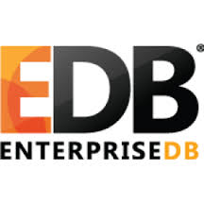
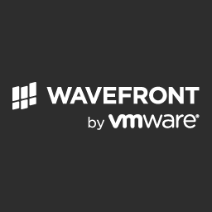







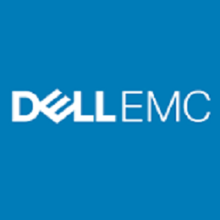
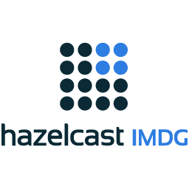
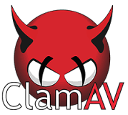
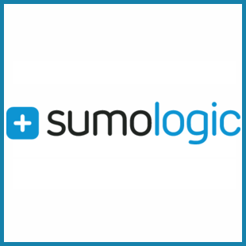



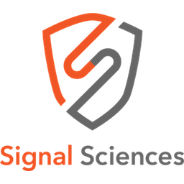



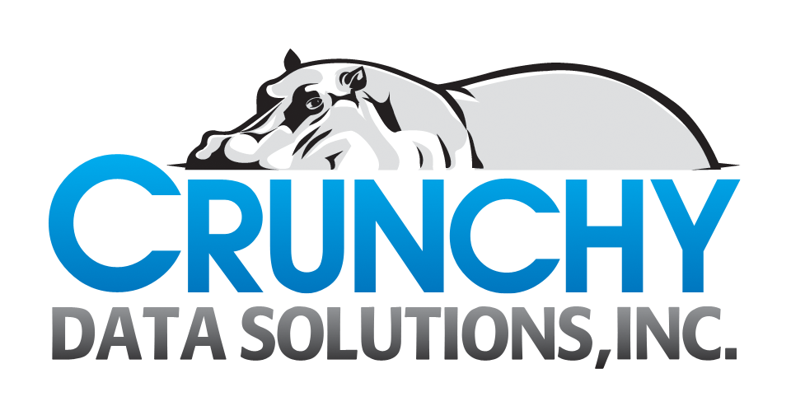







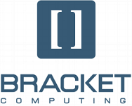
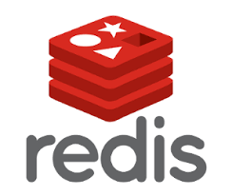
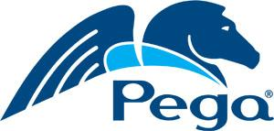


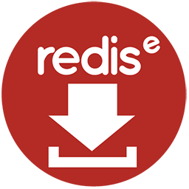




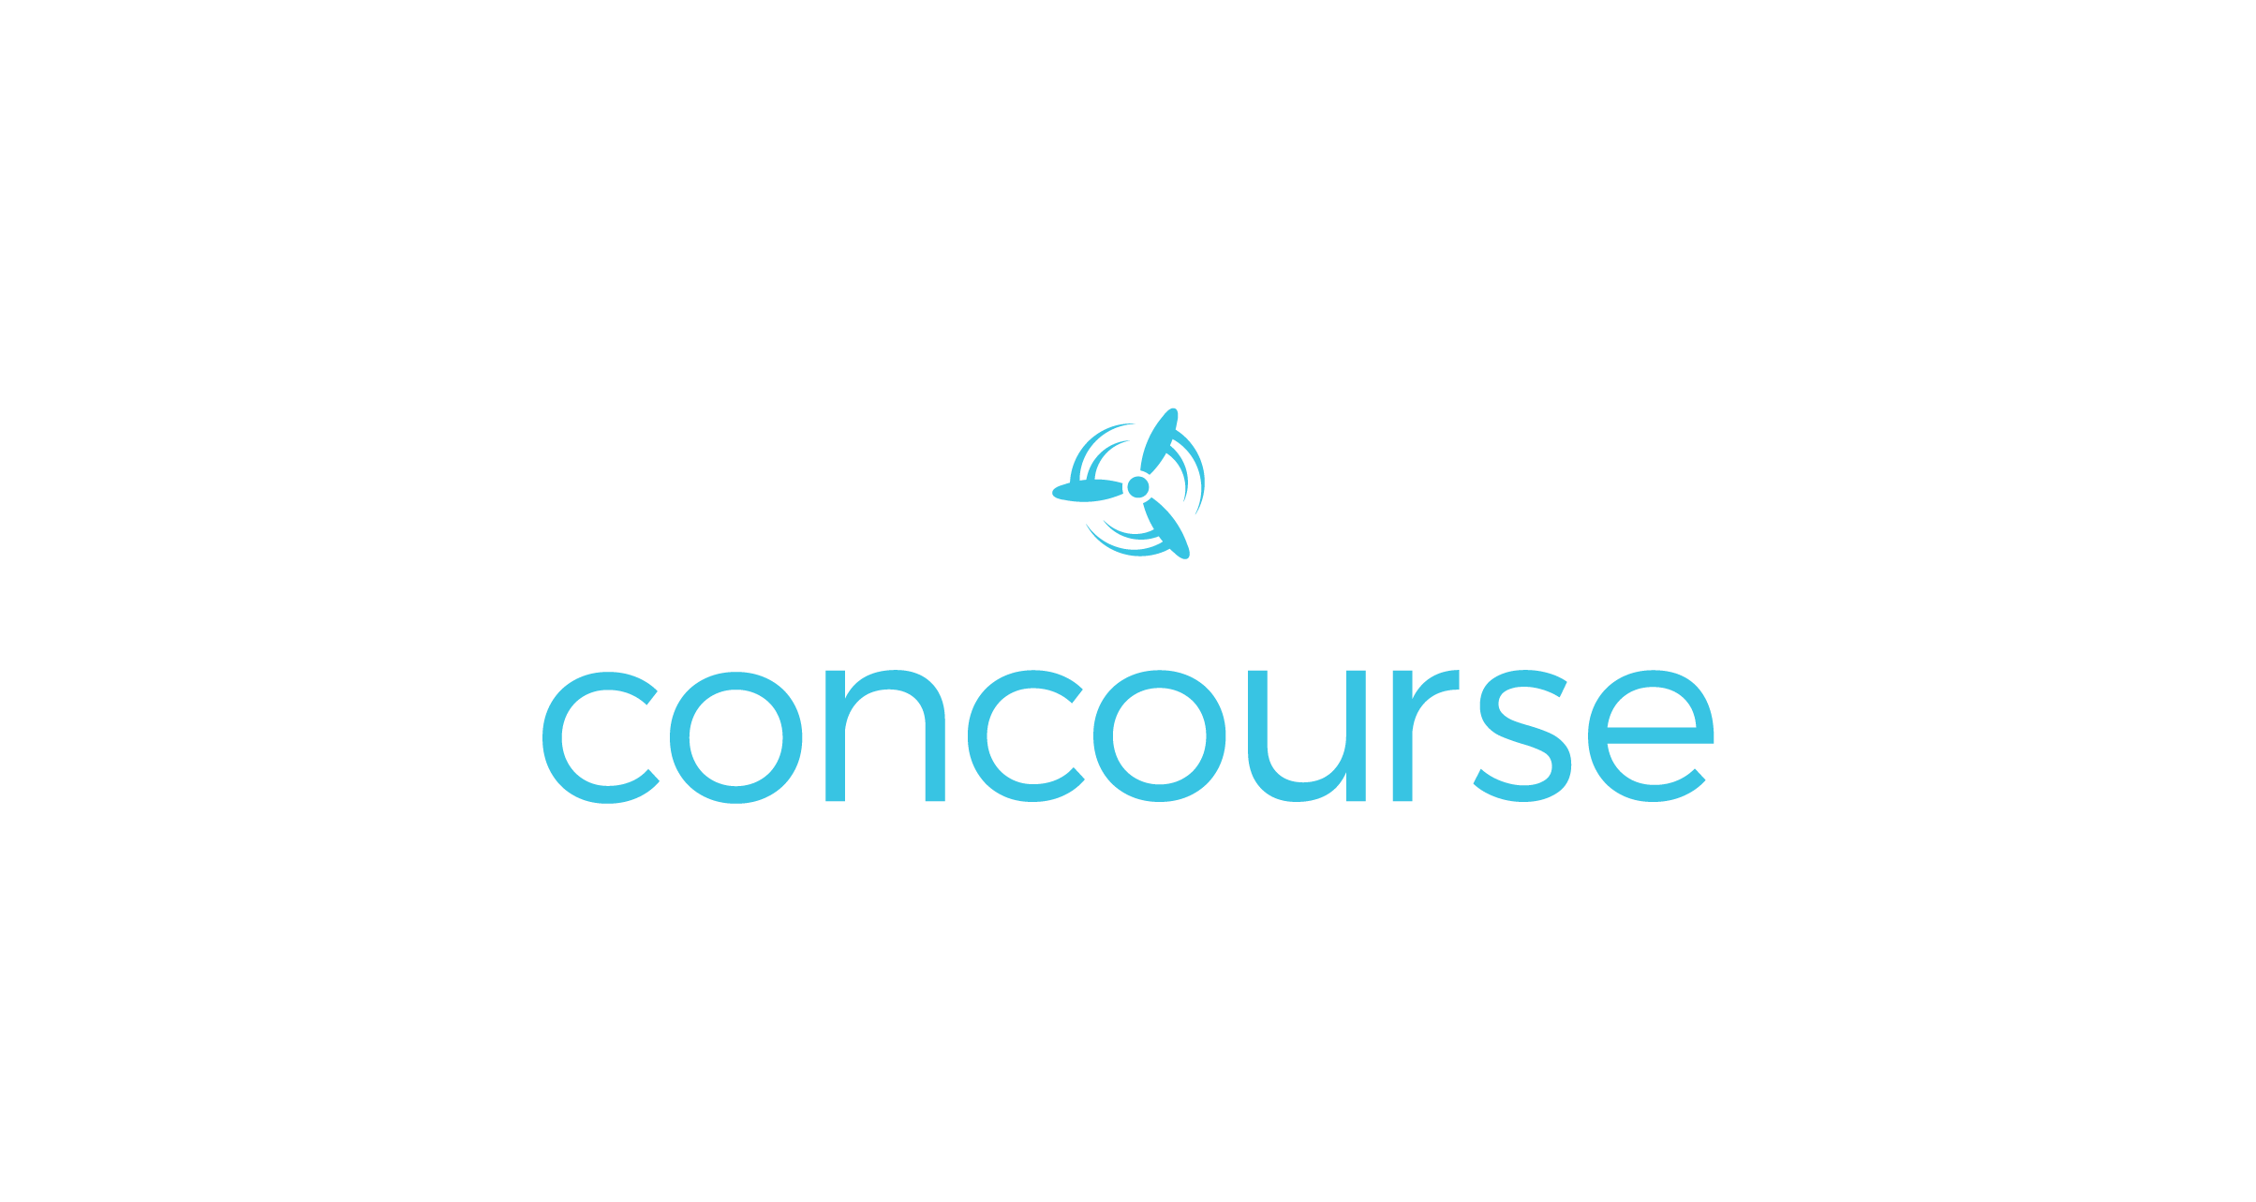




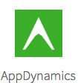
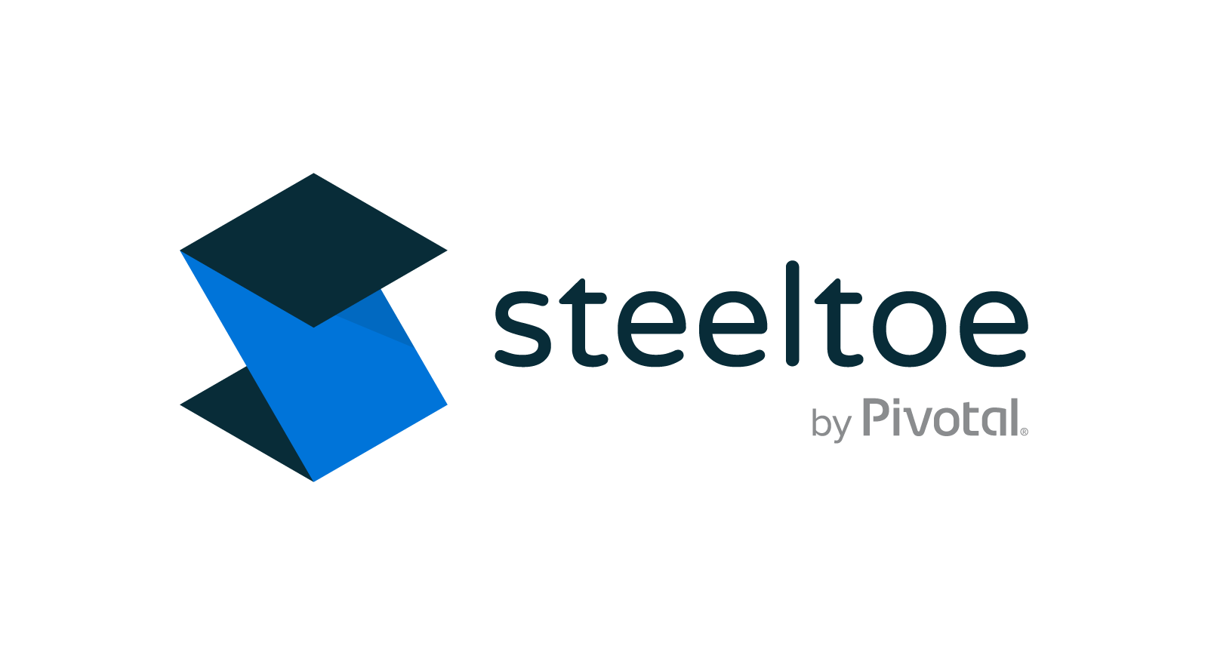
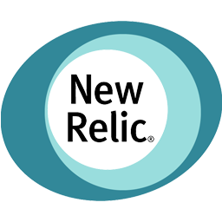

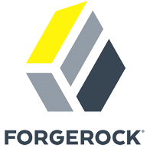









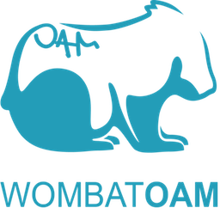





The Growing PCF Ecosystem
Mobile
Networking
Data Management
API Gateways
Messaging
SIEM/Log/Audit
Storage
Security
BPM
Search
App Integration
IaaS
DevOps Tooling
APM/Monitoring
CRM
Microservices Management
Other
IDE/Code
IAM
Commerce
Notes:
What’s at the center of every complex organization? Correction - what should be? Answer: a solid foundation! Pivotal Cloud Foundry has an architecture that allows virtually any vendor, partner, service, product, or stream both into and outside of the platform. PCF exposes simple and flexible APIs for interacting with “service brokers”, an industry standard concept that is implemented at the core of the platform. By flowing transactions and metrics through a reliable, secure, and scalable core, businesses can ensure that anything or anyone they communicate with can be managed.
https://pivotal.io/platform/services-marketplace

Slide 9
Tools
Committed to open-source software
Pivotal packages mature open-source software (OSS) for consumption. We’re a leading contributor to OSS projects and commercialize the best of the industry.
We believe that productive developers are happy developers. Pivotal invests R&D into engineering the best tools for building software.
Notes:
Pivotal creates and contributes to the most important OSS projects. Spring is maintained by Pivotal, and represents the dominant way that Java developers build software. Steeltoe is how .NET developers build modern microservices. RabbitMQ is the most widely deployed OSS messaging software. Concourse is a popular tool for delivering software AND platforms. And data products like PCC and Greenplum offer performance for caching, and analytics, respectively.

Slide 10
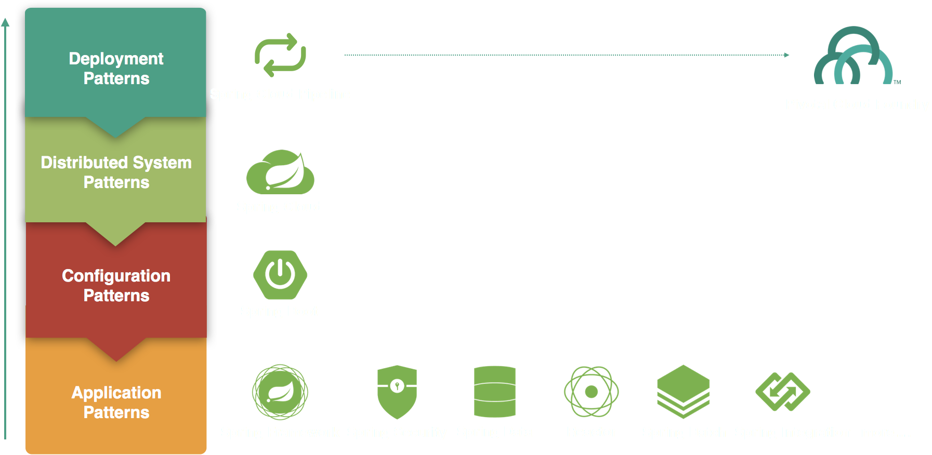
Eliminate Boilerplate Code, Focus on Business Logic
Spring Cloud Pipelines
Spring Cloud
Spring Boot
Spring Framework
Spring Security
Spring Data
Reactor
Spring Batch
Spring Integration
Notes:
PAS is at it’s best when used for stateless workloads, like web apps, REST APIs, etc. While it can handle NFS v3 mounts, PKS is a better choice for databases, search engines, etc.
Spring excels at these stateless workloads, making it an ideal fit.
When making everything from 12 factor to fully Cloud Native apps, Spring & PAS both work overtime to eliminate repetitive, boilerplate code so you can focus on what matters.
By contrast, Java EE servers were designed to be stateful, mutable, things that had to be kept alive due to instance – specific data.
If a Java Application Server process is now only starting a statically known set of Java code; the very idea of an application server changes drastically to be more about a way of performing dependency injection and including the modular services you need; that sounds more like a framework than what we’ve come to think of as a Java Application Server.
Learn more here from Redhat:
https://blog.fabric8.io/the-decline-of-java-application-servers-when-using-docker-containers-edbe032e1f30#.osullguxl
Running Spring requires only a JVM, but is also designed to automate working with lightweight Java webservers like Apache Tomcat, Netty and Undertow.

Slide 11


SCS: Config Server
Hashicorp Vault
Git Source Repos
greeting: hi
1. Push config
Dev Desktop
2. Source config
2. API keys, secrets
Config Server
Zero downtime app updates – dynamically update application configuration
1. Pull config
app A
greeting: hi
app B
greeting: hi
app C
greeting: hi
Notes:
Config Server for Pivotal Cloud Foundry (PCF) is an externalized application configuration service, which gives you a central place to manage an application’s external properties across all environments. As an application moves through the deployment pipeline from development to test and into production, you can use Config Server to manage the configuration between environments and be certain that the application has everything it needs to run when you migrate it. Config Server easily supports labelled versions of environment-specific configurations and is accessible to a wide range of tooling for managing the content.
The concepts on both client and server map identically to the Spring Environment and PropertySource abstractions. They work very well with Spring applications, but can be applied to applications written in any language. The default implementation of the server storage backend uses Git.
Spring Boot Actuator also adds a refresh endpoint to the application. This endpoint is mapped to /refresh, and a POST request to the refresh endpoint refreshes any beans which are annotated with @RefreshScope. You can thus use @RefreshScope to refresh properties which were initialized with values provided by the Config Server.
http://docs.pivotal.io/spring-cloud-services/1-5/common/config-server/writing-client-applications.html

Slide 12

SCS: Service Registry
Service Registry
Service Registry
Service Registry
Service Registry
NetflixOSS Eureka Intelligent Routing Foundation
1. register
2. discover
Producer
Consumer
3. connect
Notes:
Service Registry for Pivotal Cloud Foundry (PCF) provides your applications with an implementation of the Service Discovery pattern, one of the key tenets of a microservice-based architecture. Trying to hand-configure each client of a service or adopt some form of access convention can be difficult and prove to be brittle in production. Instead, your applications can use the Service Registry to dynamically discover and call registered services.
When a client registers with the Service Registry, it provides metadata about itself, such as its host and port. The Registry expects a regular heartbeat message from each service instance. If an instance begins to consistently fail to send the heartbeat, the Service Registry will remove the instance from its registry.
Service Registry for Pivotal Cloud Foundry is based on Eureka, Netflix’s Service Discovery server and client.

Slide 13

SCS: Circuit Breaker
Closed
on call / pass through
call succeeds / reset count
call fails / count failure
threshold reached / trip breaker
trip
breaker
Open
on call / fail
on timeout / attempt reset
Fault Tolerance Library for Distributed Systems
trip
breaker
attempt
reset
reset
Half-Open
on call / pass through
call succeeds / reset
call fails / trip breaker
Notes:
Circuit Breaker Dashboard for Pivotal Cloud Foundry (PCF) provides Spring applications with an implementation of the Circuit Breaker pattern. Cloud-native architectures are typically composed of multiple layers of distributed services. End-user requests may comprise multiple calls to these services, and if a lower-level service fails, the failure can cascade up to the end user and spread to other dependent services. Heavy traffic to a failing service can also make it difficult to repair. Using Circuit Breaker Dashboard, you can prevent failures from cascading and provide fallback behavior until a failing service is restored to normal operation.
When applied to a service, a circuit breaker watches for failing calls to the service. If failures reach a certain threshold, it “opens” the circuit and automatically redirects calls to the specified fallback mechanism. This gives the failing service time to recover.
Circuit Breaker Dashboard for Pivotal Cloud Foundry is based on Hystrix, Netflix’s latency and fault-tolerance library.

Slide 14

What is Steeltoe?
Open Source, available via NuGet and at https://steeltoe.io
Enables implementation of industry standard best practices when building resilient microservices for the cloud
Designed to give .Net capabilities Java has enjoyed with Spring Cloud
Configuration Server client
Service Discovery client
Hystrix Circuit Breaker
Management endpoints
Simplifies implementing .Net on PCF
Connectors (such as MySql, Redis, Postgres, RabbitMQ, OAuth, and others)
Configuration providers
Security providers (OAuth SSO, JWT, Redis Key Ring Storage, and others)
Logging providers
Works with both .NET Framework 4.x and .NET Core
Does not requires PCF to be used in apps

Slide 15
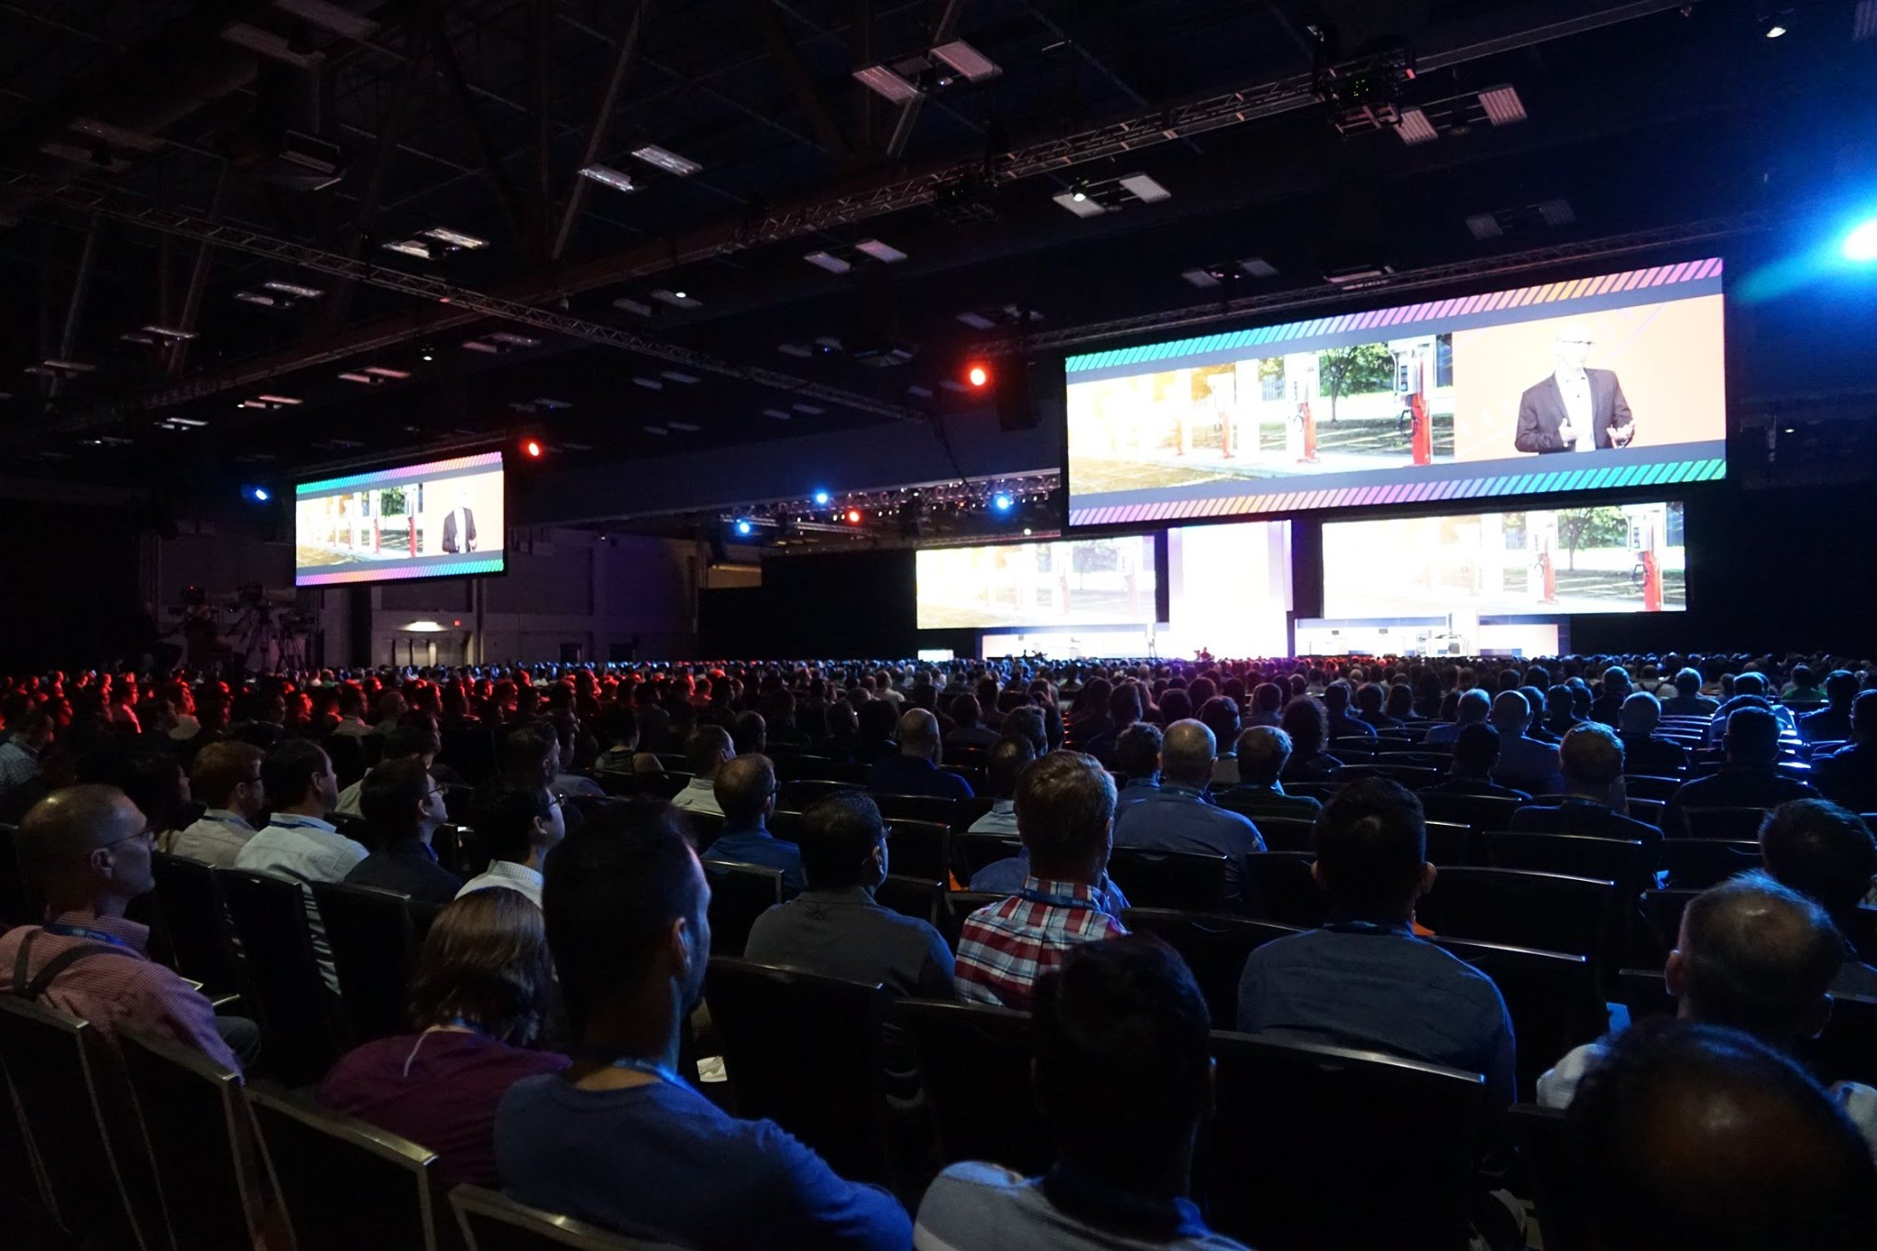
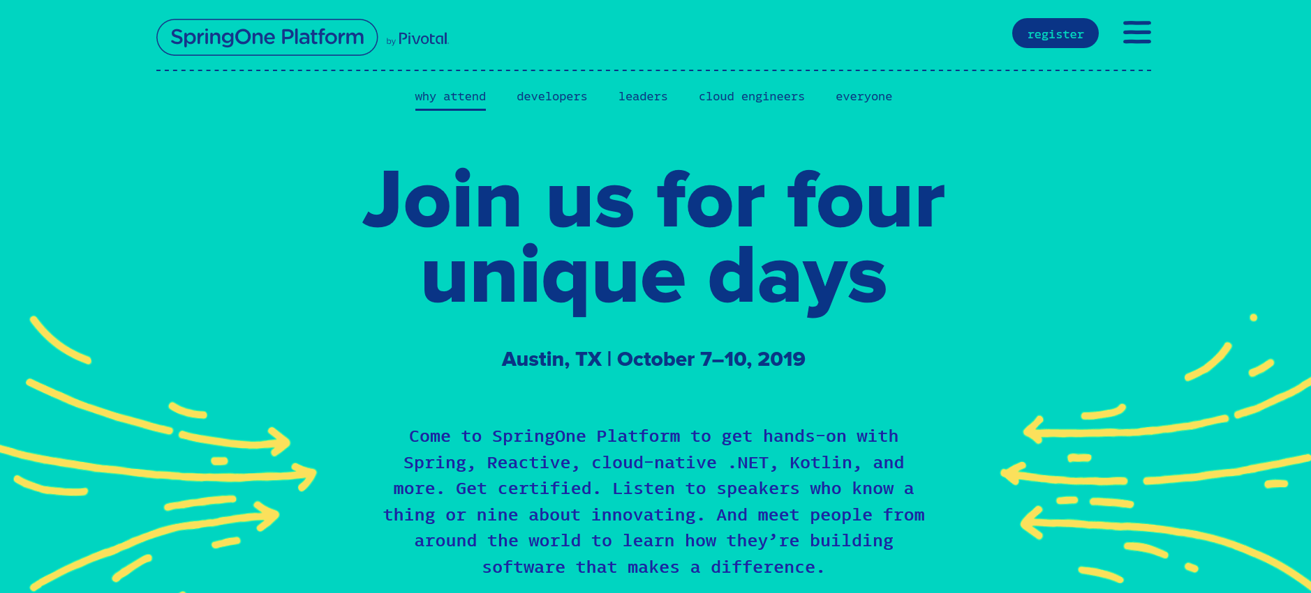

Slide 16
Conclusiones
Q+A
Crear una Cuenta Gratis https://run.pivotal.io
Steeltoe (.NET Developers) https://steeltoe.io | https://github.com/steeltoeoss
Spring One Platform Octubre https://springoneplatform.io/

Slide 18
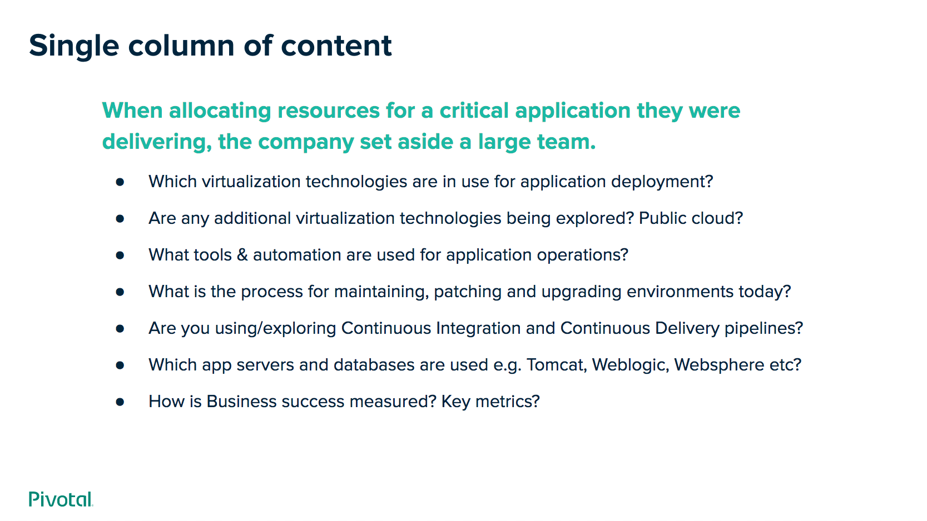
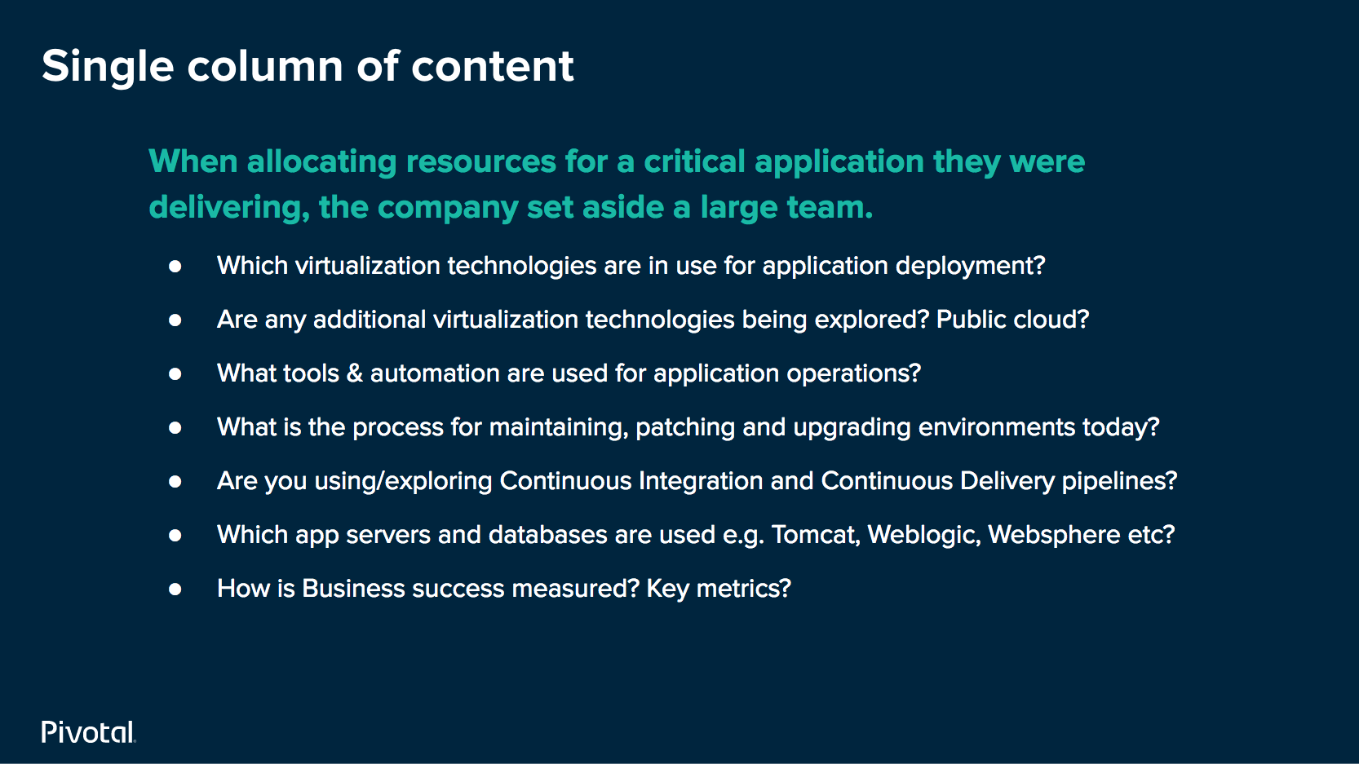
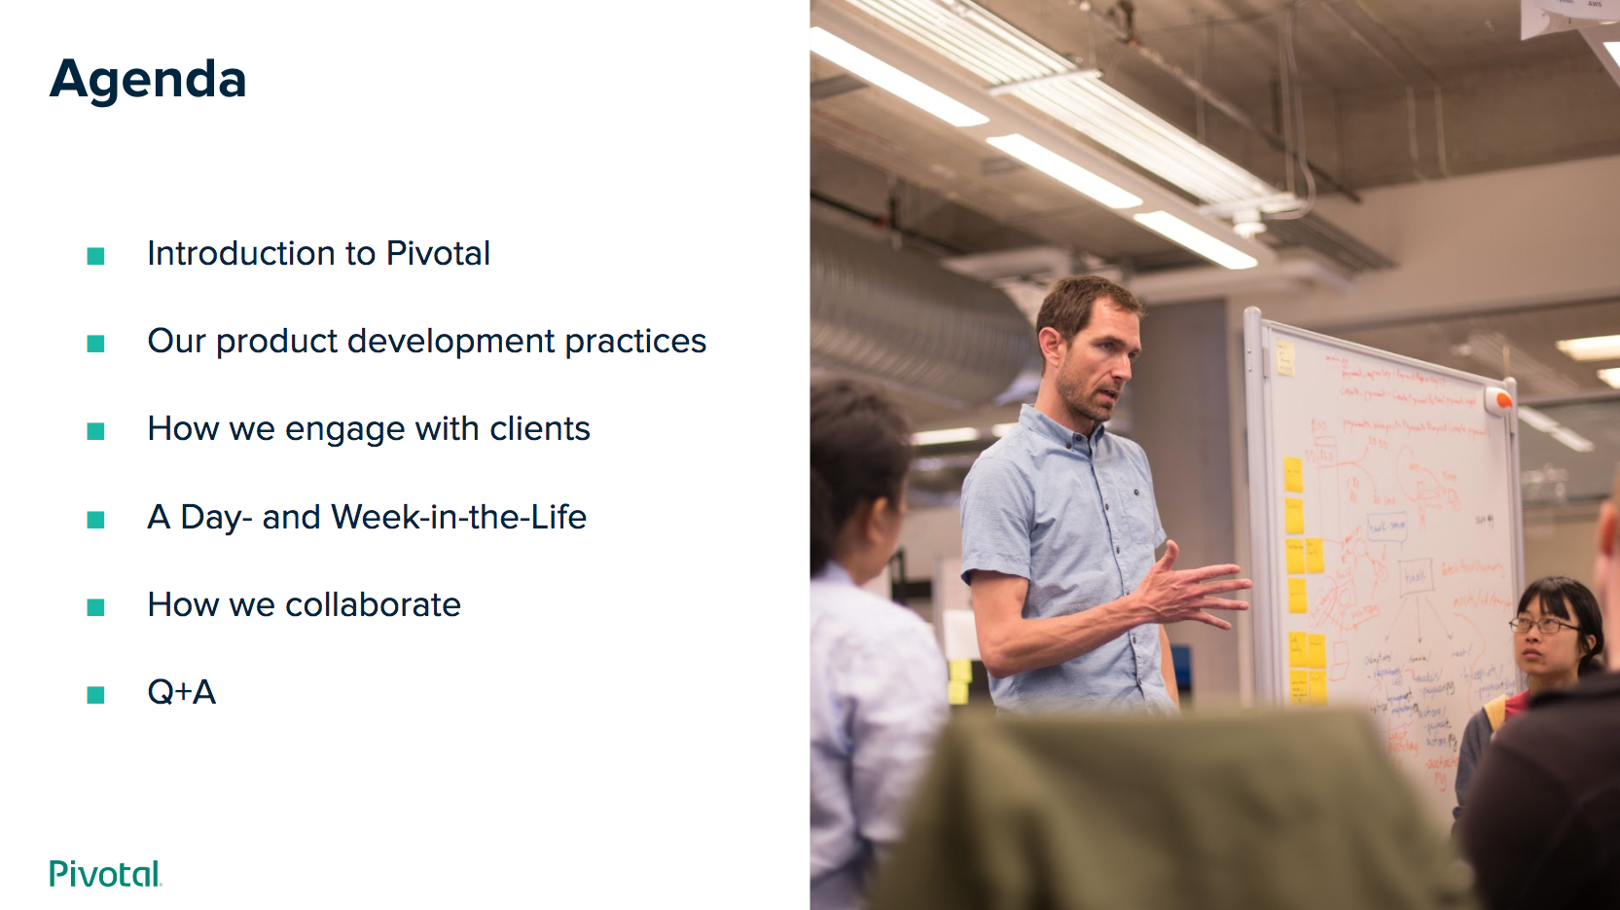
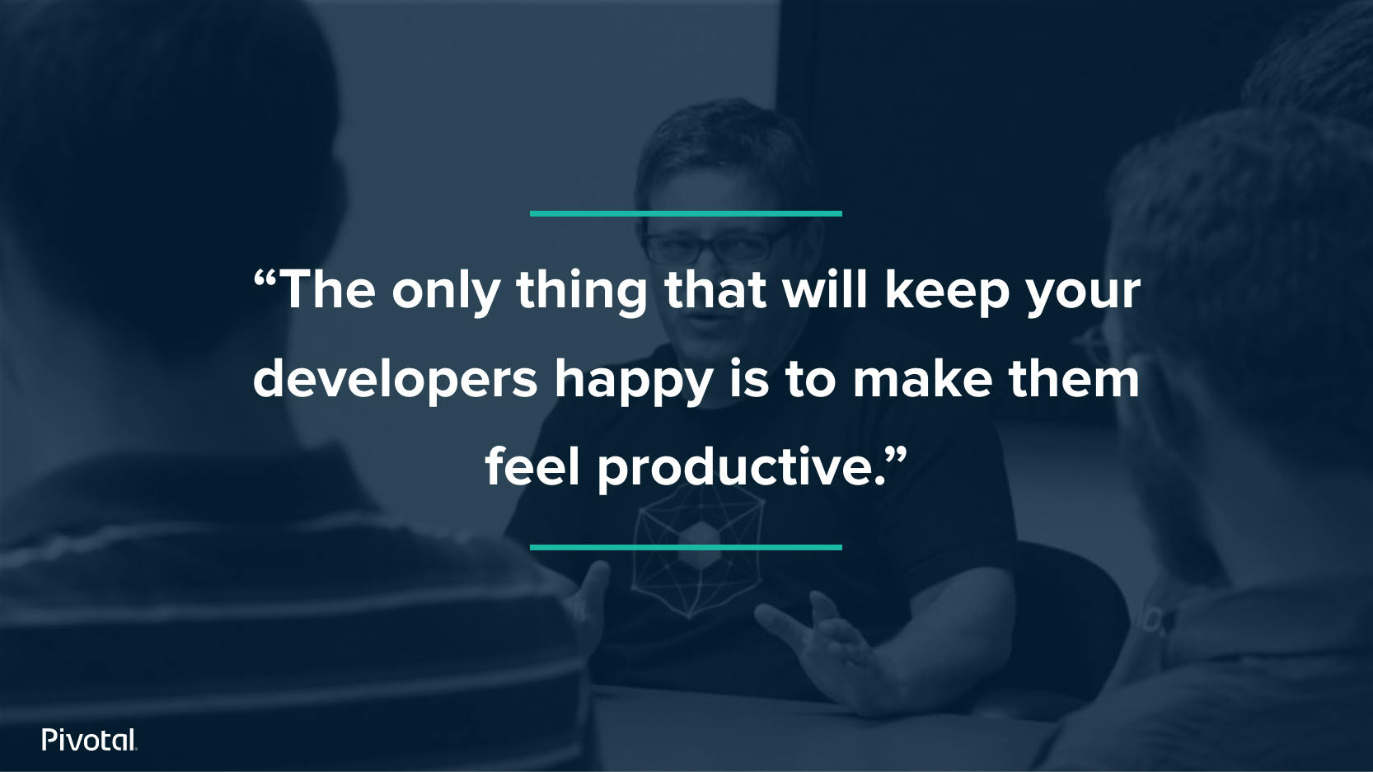
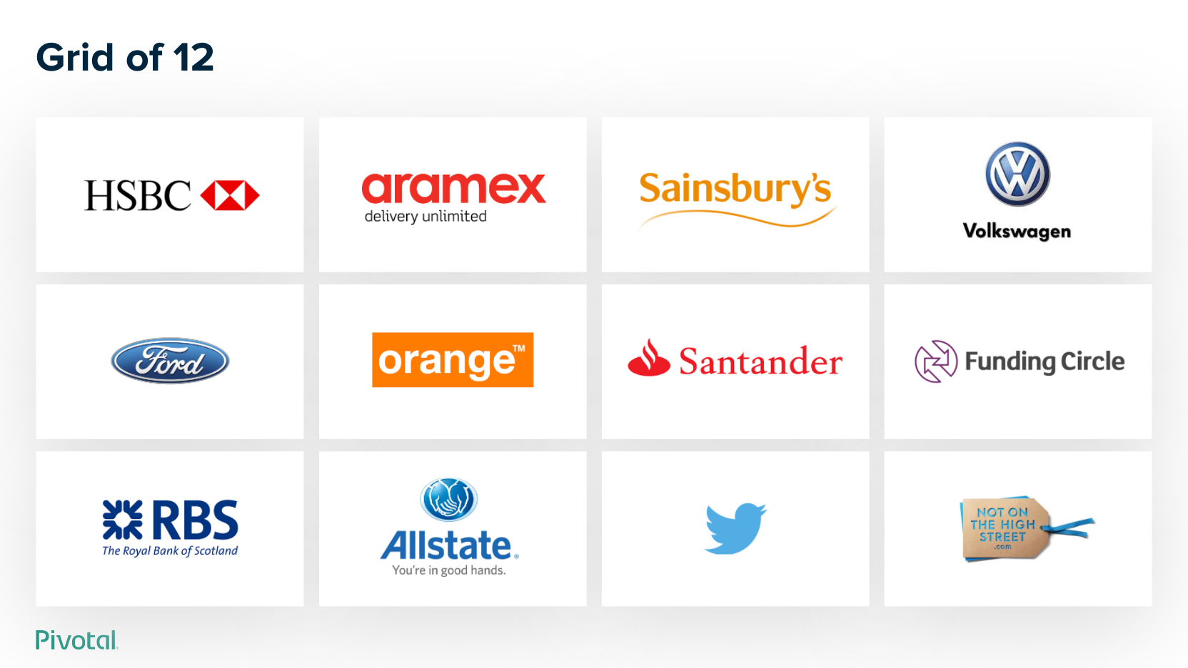
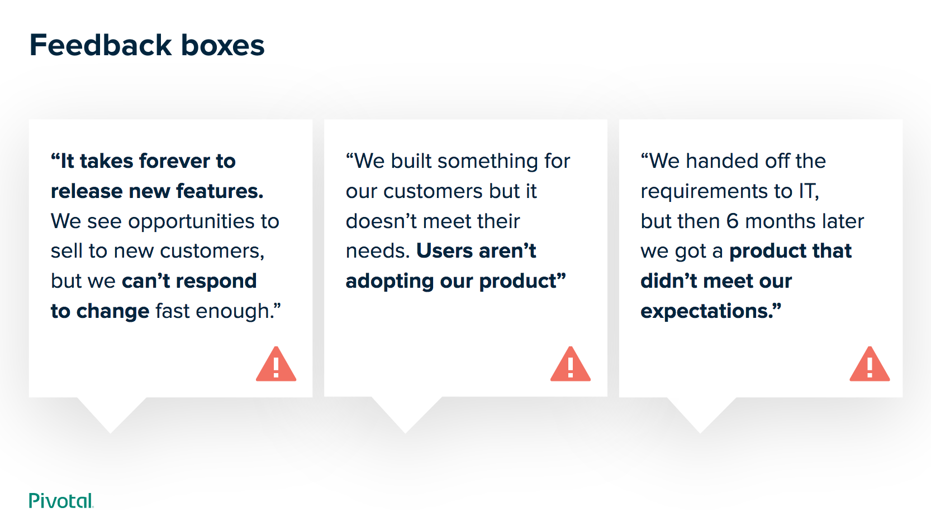
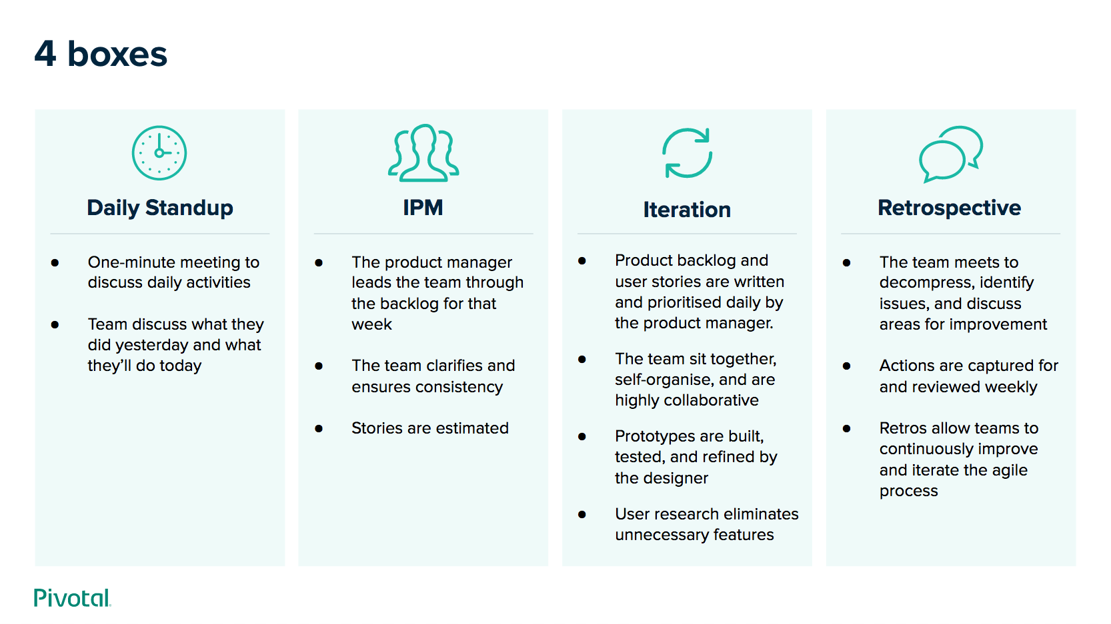
Starter Decks
Quick Start Day mode
Quick Start night mode
Quick start deck of just the basics. (This is the deck you are viewing)
Quick start deck of just the basics. Go to deck »
Here is a collection of handy starter decks, from simple to full featured.
collection
Example decks
Introduction to Pivotal Labs
Go to deck »
A collection of pre-built slide designs to jumpstart your presentation. Go to deck »

Slide 19
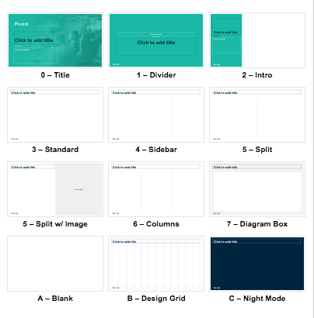
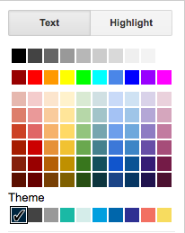
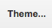
Theme Basics
Built-in layouts
Brand colors
The Pivotal Presentation Theme is built for Google Slides.
For consistency across the company, please use the built-in layouts and brand colors.
Looking for a Night Mode deck? Go to deck »
brand colors Built-in
Import Themes to Existing Deck
To import these layouts into an existing deck:
In your deck, click the Theme button
The Themes panel will open. Click “Import theme” at bottom.
Find this deck “COLLECTION — Pivotal Presentation Kit”
When prompted, select “Pivotal Presentation Theme v1”
WARNING: Results vary widely. Complex decks tend to require significant rework.

Slide 20
Basic Slides
PIVOTAL PRESENTATION THEME

Slide 21
Single column of content
When allocating resources for a critical application they were delivering, the company set aside a large team.
Which virtualization technologies are in use for application deployment?
Are any additional virtualization technologies being explored? Public cloud?
What tools & automation are used for application operations?
What is the process for maintaining, patching and upgrading environments today?
Are you using/exploring Continuous Integration and Continuous Delivery pipelines?
Which app servers and databases are used e.g. Tomcat, Weblogic, Websphere etc?
How is Business success measured? Key metrics?

Slide 22
Content with sidebar
When allocating resources for a critical application they were delivering.
Which virtualization technologies are in use for application deployment?
Are any additional virtualization technologies being explored? Public cloud?
What tools & automation are used for application operations?
What is the process for maintaining, patching and upgrading environments today?
Which virtualization technologies are in use for application deployment?
Are any additional virtualization technologies being explored? Public cloud?
What tools & automation are used for application operations?
What is the process for maintaining, patching and upgrading environments today?

Slide 23
Two columns of content
Headline for column 1
Which virtualization technologies are in use for application deployment?
Are any additional virtualization technologies being explored? Public cloud?
What tools & automation are used for application operations?
What is the process for maintaining, patching and upgrading environments today?
Are you using/exploring Continuous Integration and Continuous Delivery pipelines?
Headline for column 2
Which virtualization technologies are in use for application deployment?
Are any additional virtualization technologies being explored? Public cloud?
What tools & automation are used for application operations?
What is the process for maintaining, patching and upgrading environments today?
Are you using/exploring Continuous Integration and Continuous Delivery pipelines?

Slide 24
Three columns of content
Headline for column 1
Which virtualization technologies are in use for application deployment?
Are any additional virtualization technologies being explored? Public cloud?
What tools & automation are used for application operations?
What is the process for maintaining, patching and upgrading environments today?
Headline for column 2
Which virtualization technologies are in use for application deployment?
Are any additional virtualization technologies being explored? Public cloud?
What tools & automation are used for application operations?
What is the process for maintaining, patching and upgrading environments today?
Are you using/exploring Continuous Integration and Continuous Delivery pipelines?
Headline for column 3
Which virtualization technologies are in use for application deployment?
Are any additional virtualization technologies being explored? Public cloud?
What tools & automation are used for application operations?

Slide 25
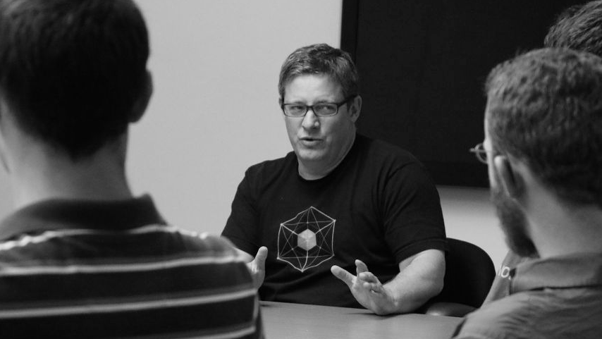
“The only thing that will keep your developers happy is to make them feel productive.”

Slide 26

What will our team look like?

Slide 27

Transforming How The World Builds Software
© Copyright 2019 Pivotal Software, Inc. All rights Reserved.

